Slide 1
Supply chain attacks on package managers
by Martin Carnogursky
admin@sourcecode.ai

Slide 2
Introduction
How python packaging works
What is a software supply chain?
Types of attacks on the supply chain
Get involved
  SourceCode.AI (Aura & Ambience)
  OpenSSF
Notes:
Co su balicky a ako to suvisi z repozitarom, PyPI, zdielanie v open source

Slide 3
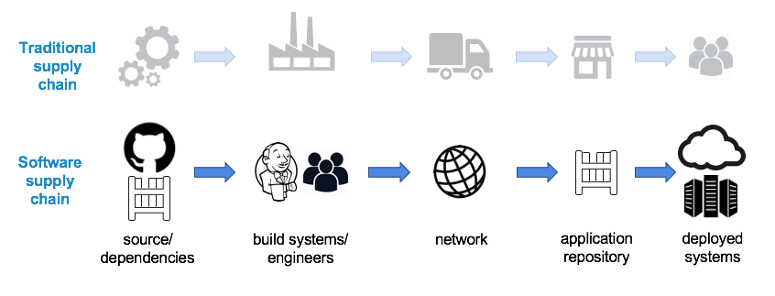
What is a supply chain?
Image source: http://img.scoop.it/Fwh7RipNyY3N384cITe5qbnTzqrqzN7Y9aBZTaXoQ8Q=
Notes:
5:00 min
Co je sfotwarovy supply chain? Porovnanie s hw supply chain
Bezpecnost aj pocas prevozu
Supply chain == suhrn vsetkych komponent tvoriacich software -> baliky
Aby sme pochopily utoky musime si ukazat ako balicky vznikaju

Slide 4
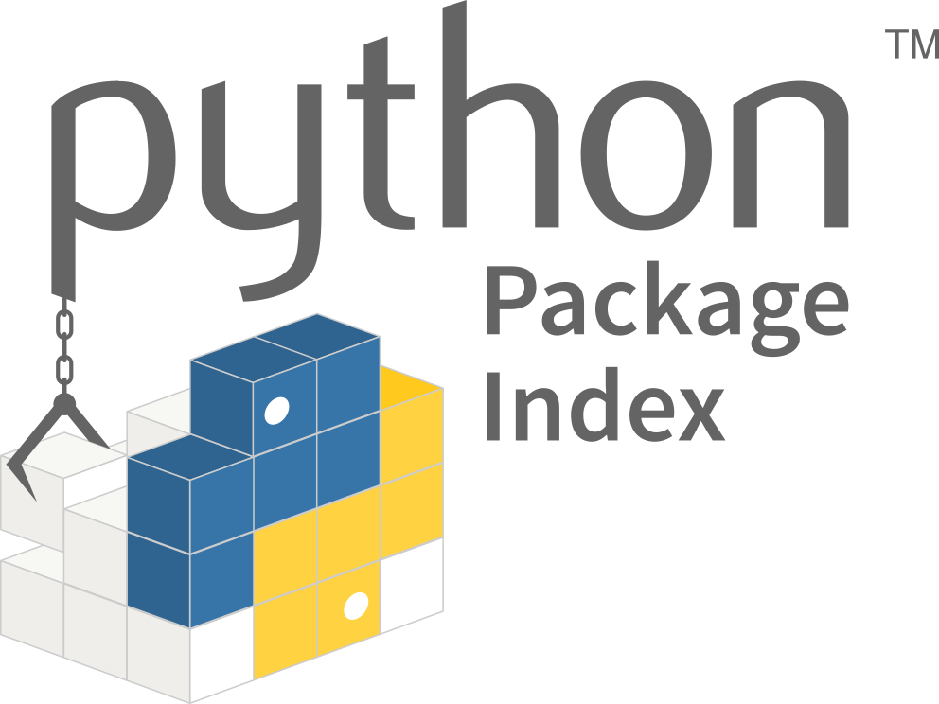
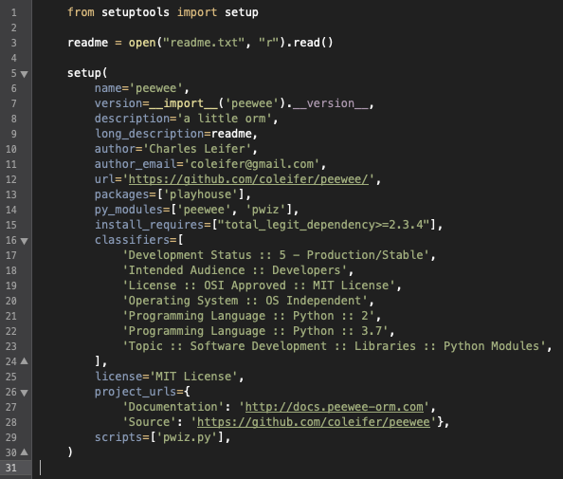
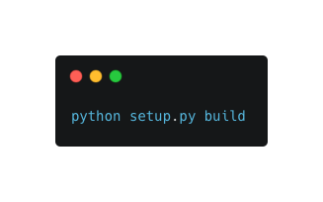
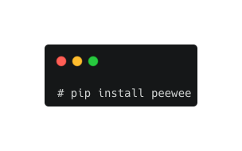
Setup.py
peewee-2.27.1.tar.gz
Notes:
8:20
Zdrojovy kod -> setup.py -> build -> upload -> pip install

Slide 5
Setup.py <- „.py“ means it‘s executable
setup( # We are in fact calling a python function with the following arguments
...
name='windows95',
author='Bill Gates',
author_email='bill.gates@microsoft.com',
url='https://github.com/coleifer/peewee/',
packages=['requests', 'cGVld2Vl\n'.decode('base64') , 'ipaddress'],
install_requires=random.choice(["pkg1", "pkg2", "pkg3", "pkg4", "pkg5"]),
...
)
Notes:
6:30 min
Moznost falsovat udaje: meno, email, url, nazov
Mozeme instalovat viacej balickov
Nahodne zavislosti
Vsetko je to len spustileny python kod
Spusta sa aj pri instalacii
Problem vo vsetkych jazykoch, textovy format to uplne neriesi
Prechadzame k utokom ktore z toho vyplyvaju

Slide 6
Types of attacks
Namesquatting
  Typosquatting
    Stub package
  Phishing
    Starjacking
  Dependency confusion
Existing packages
  Malicious dependency
  Package takeover
    Dependency hijack
    Source code modification
Notes:
Utoky rozdelujeme na dve velke kategorie
Typosquatting -> next slide

Slide 7
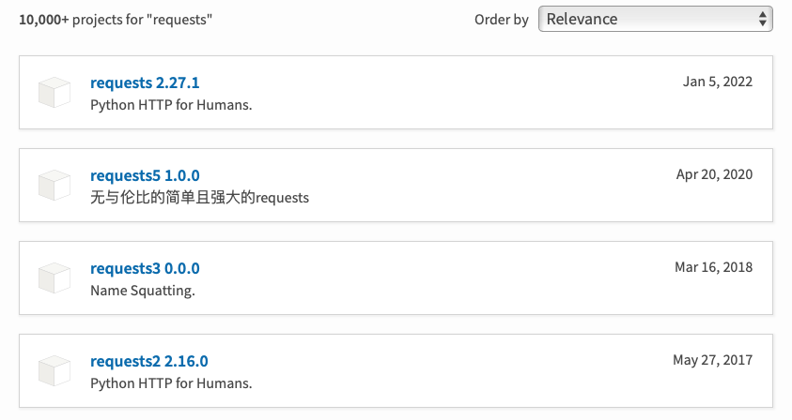
Typosquatting/namesquatting
Notes:
Skopirujeme obsah vs stub package proti odhaleniu
Peewee test

Slide 8
What was the name again?
pip install pewe
pip install peewe
pip install pewee
pip install peewee
Notes:
18:50

Slide 9
Types of attacks
Namesquatting
  Typosquatting
    Stub package
  Phishing
    Starjacking
  Dependency confusion
Existing packages
  Malicious dependency
  Package takeover
    Dependency hijack
    Source code modification

Slide 10
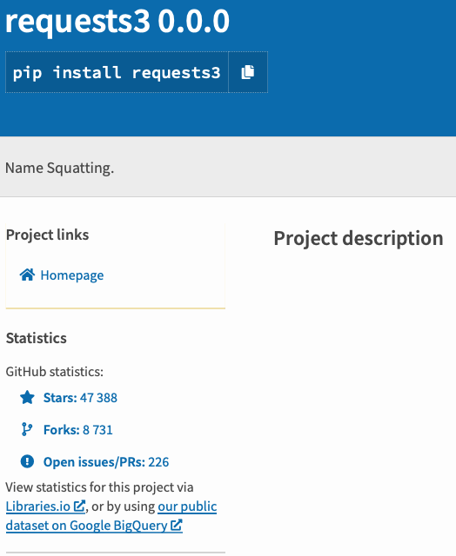
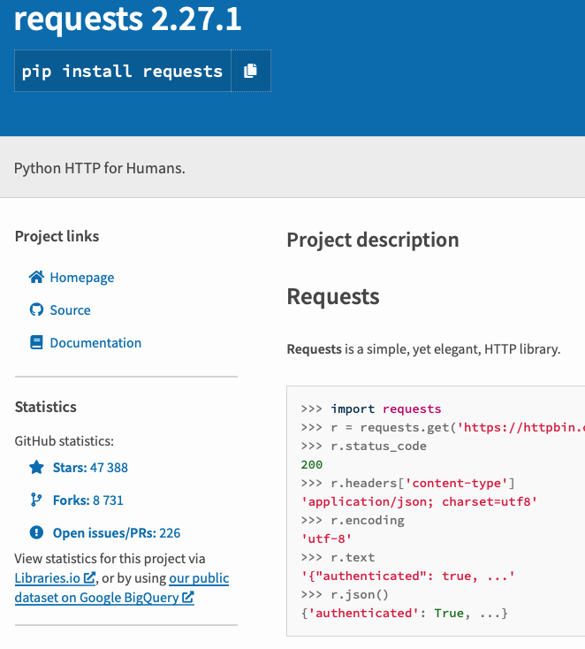
Starjacking

Slide 11
Types of attacks
Namesquatting
  Typosquatting
    Stub package
  Phishing
    Starjacking
  Dependency confusion
Existing packages
  Malicious dependency
  Package takeover
    Dependency hijack
    Source code modification

Slide 12
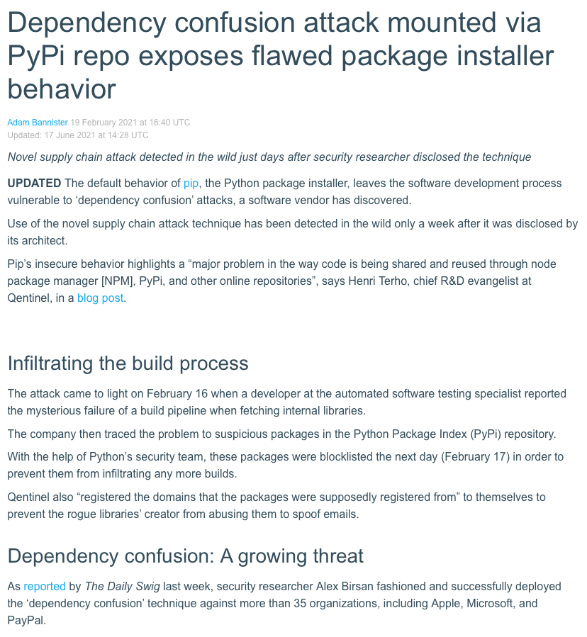
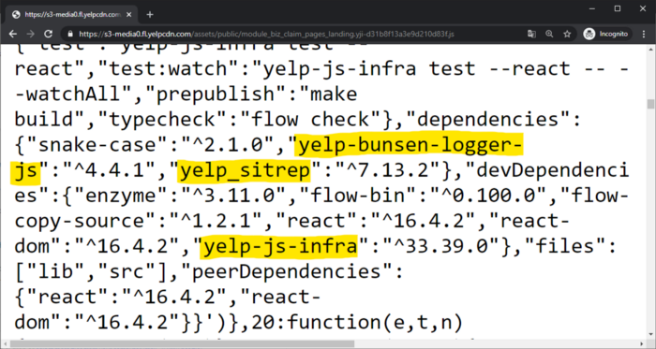
Dependency confusion
Source:
https://portswigger.net/daily-swig/dependency-confusion-attack-mounted-via-pypi-repo-exposes-flawed-package-installer-behavior
https://medium.com/@alex.birsan/dependency-confusion-4a5d60fec610

Slide 13
Types of attacks
Namesquatting
  Typosquatting
    Stub package
  Phishing
    Starjacking
  Dependency confusion
Existing packages
  Malicious dependency
  Package takeover
    Dependency hijack
    Source code modification

Slide 14
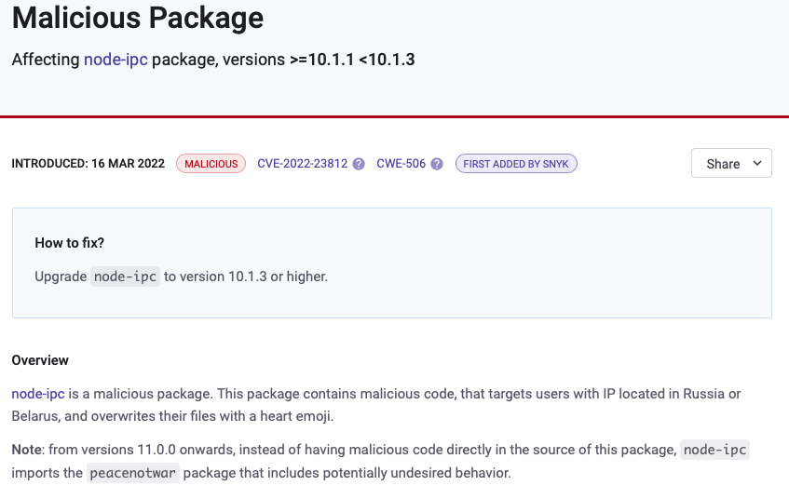
Source: https://security.snyk.io/vuln/SNYK-JS-NODEIPC-2426370
Notes:
Prispievanie do projektu -> zavedenie novej zavislosti

Slide 15
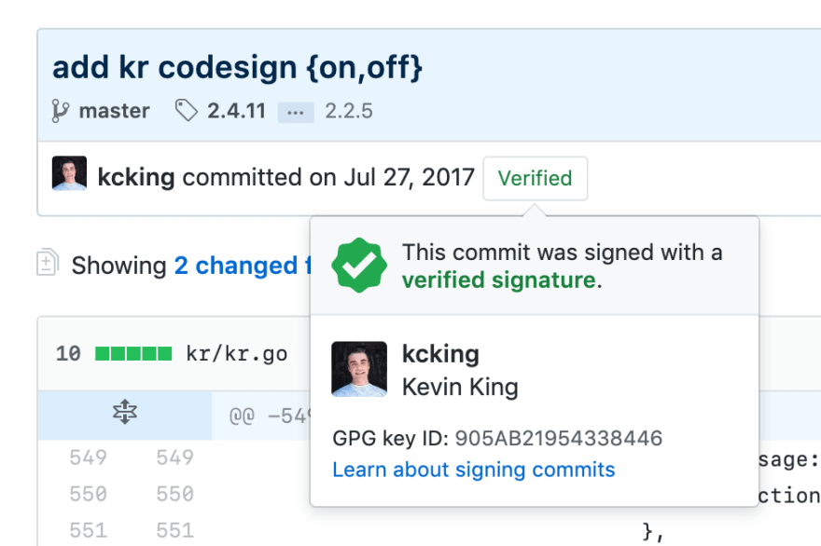
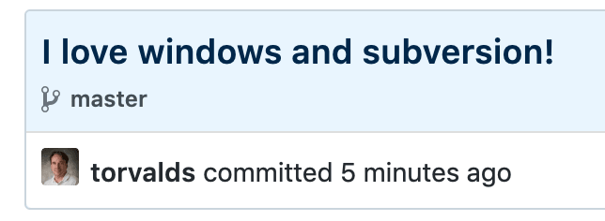
Exploiting PRs/commits workflow
GitHub diff view doesn‘t like NULL characters
Automatic trigger of CI pipeline
  Self-approve PRs
Add new CI/CD workflows
Fake digital signatures

Slide 16
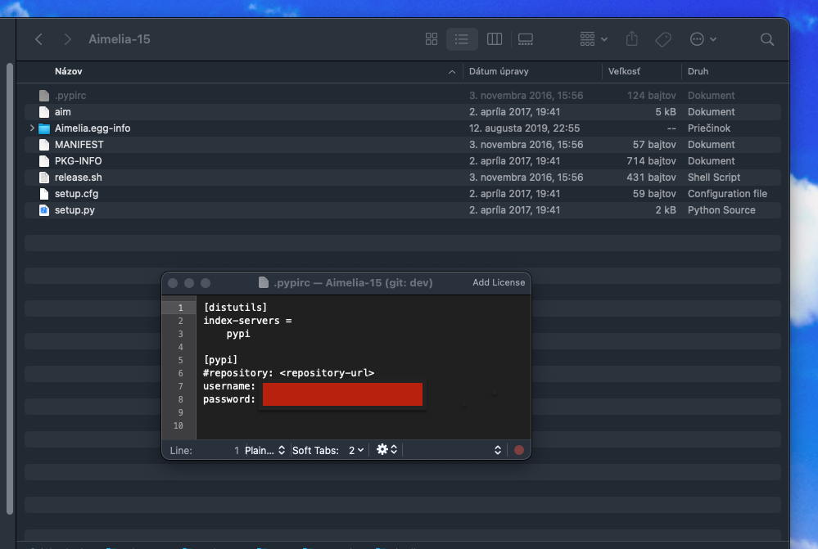
Leaking credentials

Slide 17

It‘s not important, or is it?
Is maintainer of
Contains pypi password for
User aclark
Pillow: Image processing library
14323814 | Downloads
3324 | # of dependencies
17.05.2022 | Last updated
Aimelia: simple todo list (?)
723 | Downloads
0 | # of dependencies
02.04.2017 | Last updated
More important
Less important
This doesn‘t always work...
Disclaimer: Not recent, found in 2018, first significant finding of the Aura project.
Reported to Python security team and forced password reset.

Slide 18
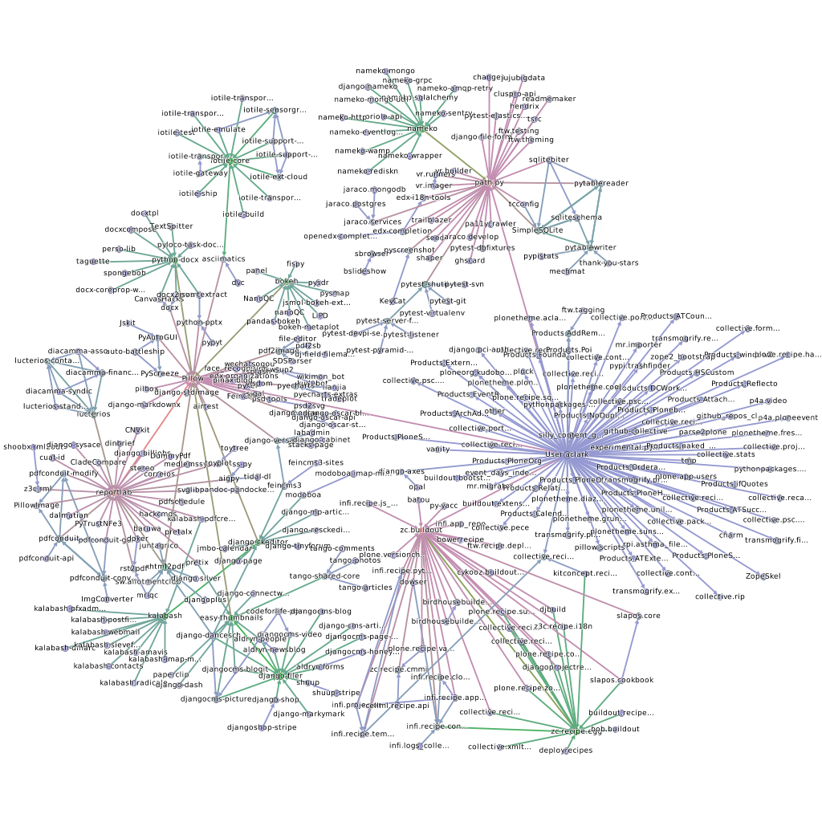
Threat modeling via graphs
By compromising user aclark we have access to all these packages via (in)direct dependencies.
Compromising key strategic packages/users is enough to compromise most of the pypi ecosystem.

Slide 19
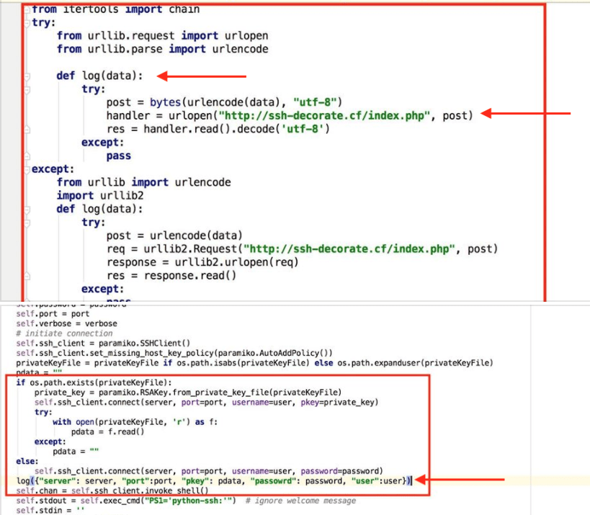
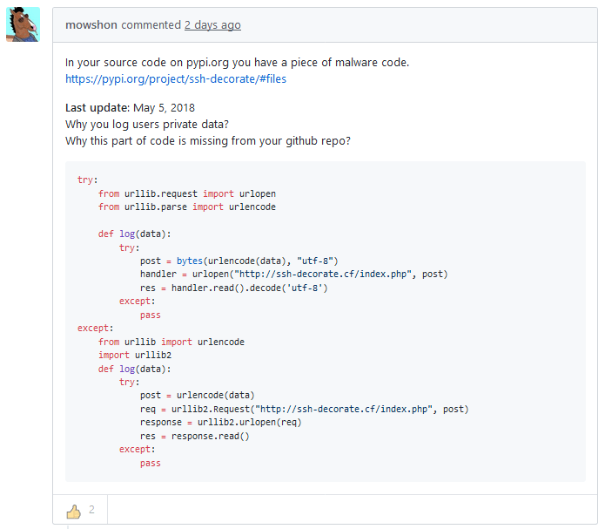
Source code modifications

Slide 20
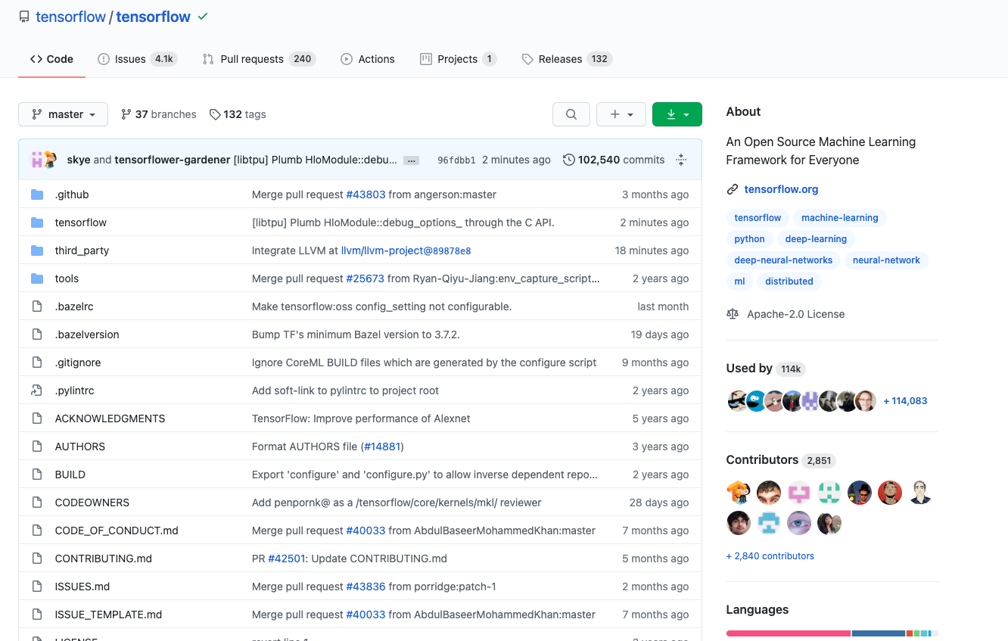
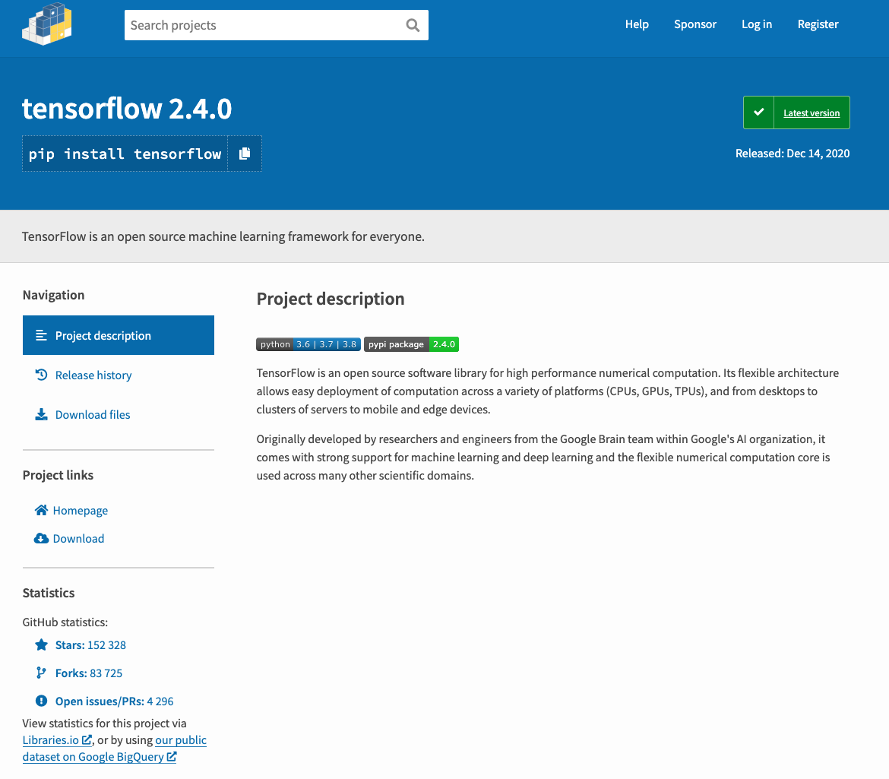
Reproducible builds
How can we make sure, whatever is in github is the exact same version deployed on pypi without any additional modifications such as malware, backdoors etc?
More reading: https://reproducible-builds.org

Slide 21
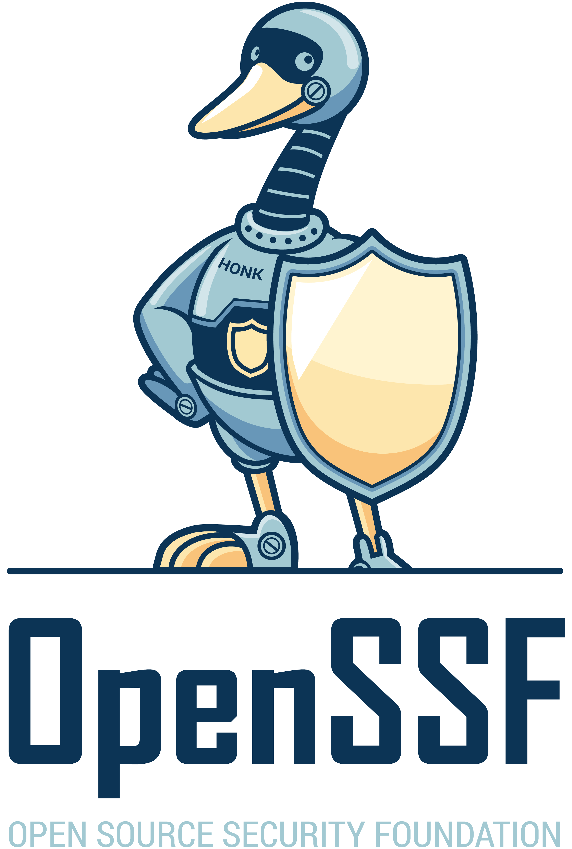
^SourceCode\.AI$
admin@sourcecode.ai
^Aura$
^Ambience$
https://openssf.org

Slide 22
Backup slides

Slide 23
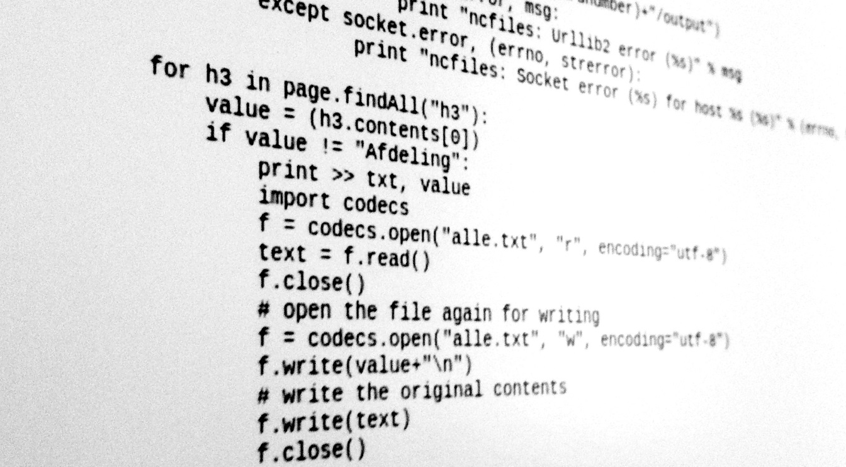
Behavioral analysis
We can auto-sumarize the changes made in a code
  Part of `aura diff`
Static behavioral indicators
Privilege escalation
Tampers with user/account privileges
Enumerates system information using VMI
Reads information about one or more running processes
Sounds familiar?

Slide 24
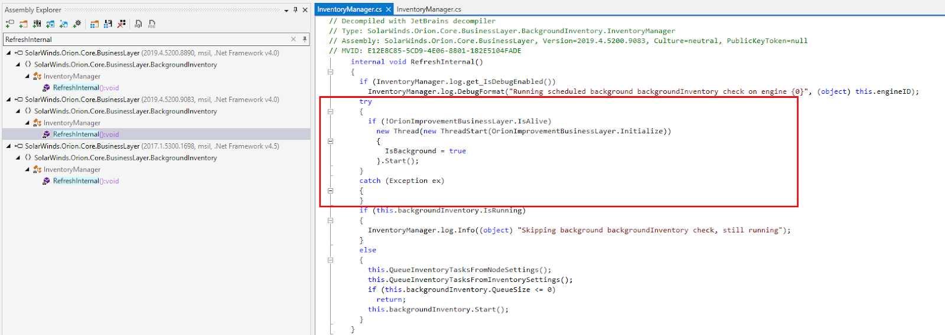
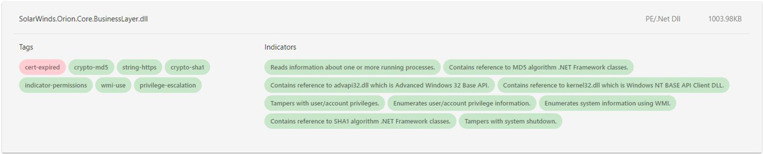
2021 Solarwinds breach...
Attackers even mimicked the coding style of developers to remain stealth
Could be (arguably) easily detected by behavioral indicators
Static behavioral indicators
Privilege escalation
Tampers with user/account privileges
Enumerates system information using VMI
Reads information about one or more running processes
Source: https://blog.reversinglabs.com/blog/sunburst-the-next-level-of-stealth

Slide 25
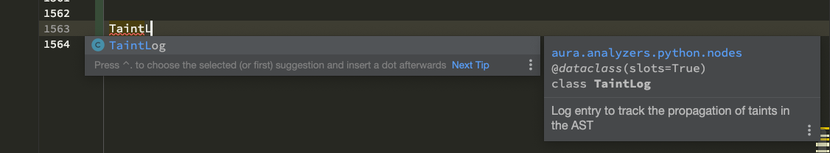
Example of linting

